Slide 1
LISTING PRESENTATION
Prepared Exclusively for [Client Information]

Slide 2
WELCOME
Thank you for giving Save Max the opportunity to present before you & the potential opportunity to represent you in the sale of your home.
Your HOME is UNIQUE; Both as a place where you have built many memories and as a significant asset. We are respectful of your home & mindful of our responsibility to maximize its value in a short timeframe.

Slide 3
ABOUT
SAVE MAX
CORPORATE OFFICE:
305-1550 Enterprise Rd,
Mississauga, ON

Slide 4
About
60+ GLOBAL FRANCHISES
Across Canada, India & UAE
1000+ AGENTS
14+ YEARS EXPERIENCE
$20+ BILLION IN SALES
20,000+ HAPPY CUSTOMERS

Slide 5
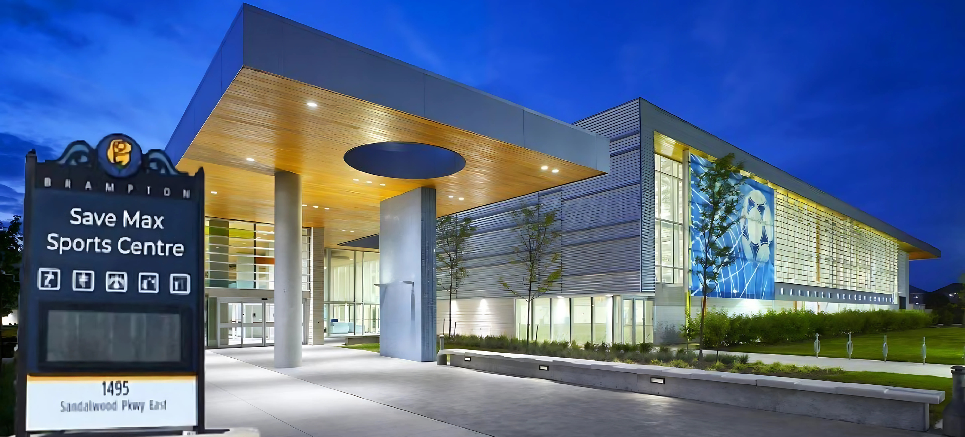
COMMUNITY ENGAGEMENT
Save Max Sports Center -
First-ever public facility naming rights agreement in Brampton, ON

Slide 6
COMMUNITY ENGAGEMENT
To the Trillium Health Network including
Credit Valley Hospital | Mississauga Hospital | Queensway Health Center
- Donations over $2.5 Million

Slide 7
AWARDS & RECOGNITION

Slide 8
AWARDS & RECOGNITION
Established in 2010, Save Max is one of the Fastest Growing Companies in GTA.
Sold over *$20+ Billion Real Estate Volume & completed *20,000+ transactions to date.
Premier full-service brokerage with top-rated agents offering the highest level of real estate services to clients.
*Total Sales Volume & and number of transactions by Save Max Real Estate Brokerage from April 2010 until today where Save Max acted as a Listing/Co-operating Brokerage.

Slide 9
STRATEGIC PARTNERS
Creating exceptional value for clients by partnering with Canada’s Leading Financial Institutions

Slide 10
DEVELOPER PARTNERSHIPS
Passing platinum privileges to our clients with excellent relationships with top property development firms.

Slide 11
DEDICATED TO YOUR SUCCESS

Slide 12
REAL ESTATE MARKET
Statistical Overview
Total Registered Agents
Toronto Real Estate Board (TREBB)
73,000
BREAKDOWN BASED ON NO. OF DEALS PER YEAR
0 Deals:
1-6 Deals:
7-12 Deals:
12-24 Deals:
25-35 Deals:
36+ Deals:
37%
47%
9%
4%
2%
Only 1%
Based on data provided by IMS for approximate deals done by agents in the Toronto real estate market

Slide 13
WHAT WE OFFER
AS A TEAM
An Elite team of professionals with an average of 4+ years of real estate experience.
Domestic and International lead base of buyers and investors.
A strong network of internal and external industry professionals.
Save Max brings the expertise and skills necessary to sell your property for its highest value.

Slide 14
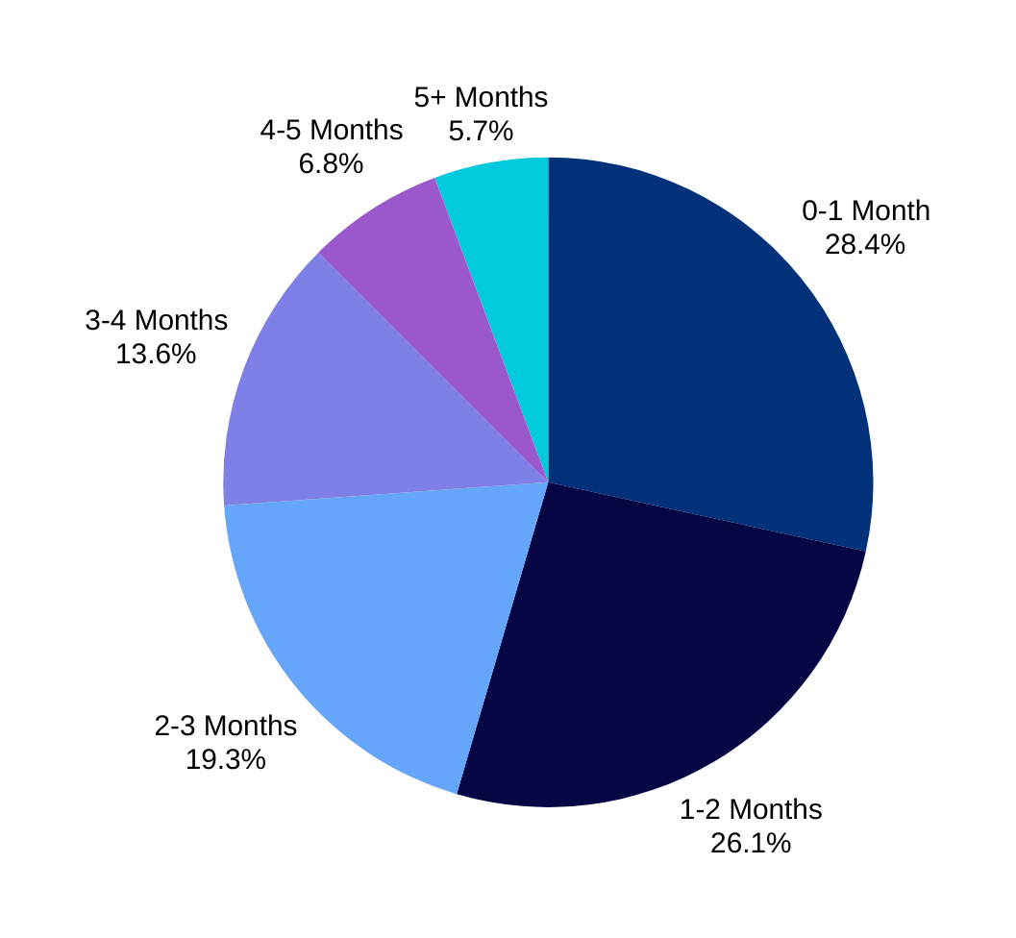
HOW LONG TILL IT’S SOLD?
Based on Save Max historical internal data

Slide 15
SECRET SAUCE
1
Extensive Pre-Planning
2
Result Oriented Marketing Effort
3
Follow-up Strategy

Slide 16
PLANNING STAGE
To attract the right buyers...
MLS
Yard Sign Design
Pricing Strategy
Record Virtual Tour
Create Feature Sheet
Schedule Professional Staging

Slide 17
PLANNING STAGE
To attract the right buyers...
MLS
Yard Sign Design
Pricing Strategy
Record Virtual Tour
Create Feature Sheet
Schedule Professional Staging

Slide 18
PLANNING STAGE
To attract the right buyers...
MLS
Yard Sign Design
Pricing Strategy
Record Virtual Tour
Create Feature Sheet
Schedule Professional Staging

Slide 19
PLANNING STAGE
To attract the right buyers...
MLS
Yard Sign Design
Pricing Strategy
Record Virtual Tour
Create Feature Sheet
Schedule Professional Staging

Slide 20
PLANNING STAGE
To attract the right buyers...
MLS
Yard Sign Design
Pricing Strategy
Record Virtual Tour
Create Feature Sheet
Schedule Professional Staging

Slide 21
PLANNING STAGE
To attract the right buyers...
MLS
Yard Sign Design
Pricing Strategy
Record Virtual Tour
Create Feature Sheet
Schedule Professional Staging

Slide 22
MARKETING YOUR PROPERTY
(Post-Listing)
Each day, we actively market your property through targeted outreach, marketplace prospecting, and strategic promotion across online and social media platforms to connect with potential buyers and maximize exposure.
Right Price
Save Max
Marketing
House Sold

Slide 23
FLYERS & PRINT MATERIALS

Slide 24
HEAVILY ADVERTISED OPEN HOUSES
1,000,000+ DIGITAL REACH

Slide 25
EMAIL MARKETING
We leverage an extensive database and a vast pool of prospective buyers to strategically market upcoming listings. By delivering thoughtfully designed and highly informative e-blasts, we ensure engagement and effectively capture the attention of thousands of targeted consumers.

Slide 26
YOUR LISTING IS SHARED ACROSS 600+ REAL ESTATE WEBSITES AND DIGITAL PLATFORMS

Slide 27
RADIO ADVERTISING

Slide 28
WHAT MAKES US THE BEST?

Slide 29
WHAT MAKES US THE BEST?
Excellent Networking
Qualified Pool of Buyers
Professional Consultation
Effective Marketing Strategy
Experience Realtor Team
Result Oriented Approach
*#1 Real Estate agent in Brampton based on transactions do by Raman Dua from 2010-2018

Slide 30
CLIENT APPRECIATION EVENTS
Each year, we host a variety of events to show our appreciation for our clients' loyalty and support. While the activities may vary annually, here are some examples of what you can look forward to:
Halloween Pumpkin Carving Contest
Holiday Wish Campaign (Supporting families in need)
Kids' Drawing Competitions
Ice Skating & Swimming Events
Roller Skating/In-line Skating Activities
Exclusive Movie Screenings
Annual Client Appreciation BBQ
...and much more!

Slide 31
COMMISSION PACKAGES

Slide 32
PACKAGE LIST & FEATURES
Value Package
Silver Package
Gold Package
(List for $999)
(1.5%)
(2.5%)
MLS
MLS
MLS
Yard Sign
Yard Sign
Yard Sign
Website Exposure
Website Exposure
Website Exposure
HD Images & Video
HD Images & Video
HD Images & Video
Open House
Open House
Newspaper Ads (5)
Newspaper Ads (15)
Featured Flyers
Featured Flyers
3D Virtual Tour
3D Virtual Tour
Radio Ads (2)
Radio Ads (4)
House Staging
TV Exposure

Slide 33
GETTING STARTED
IS EASY.
Once we finalize the package and address all your questions, we'll complete the necessary paperwork. After that, your home can be listed on the market in as little as 48 hours.

Slide 34
THANK YOU
MOBILE: 647.225.5780
OFFICE: 905.459.7900
EMAIL: raman.dua@savemax.com

