Slide 1

Prepared Exclusively for [Client Information]
SELLING
YOUR HOME

Slide 2
WELCOME
Thank you for giving Save Max the opportunity to present before you & the potential opportunity to represent you in the sale of your home.
Your HOME is UNIQUE ; Both as a place you have built many memories in and as a significant asset. We are respectful of your home & mindful of our responsibility to maximize its value in minimum timeframe.

Slide 3
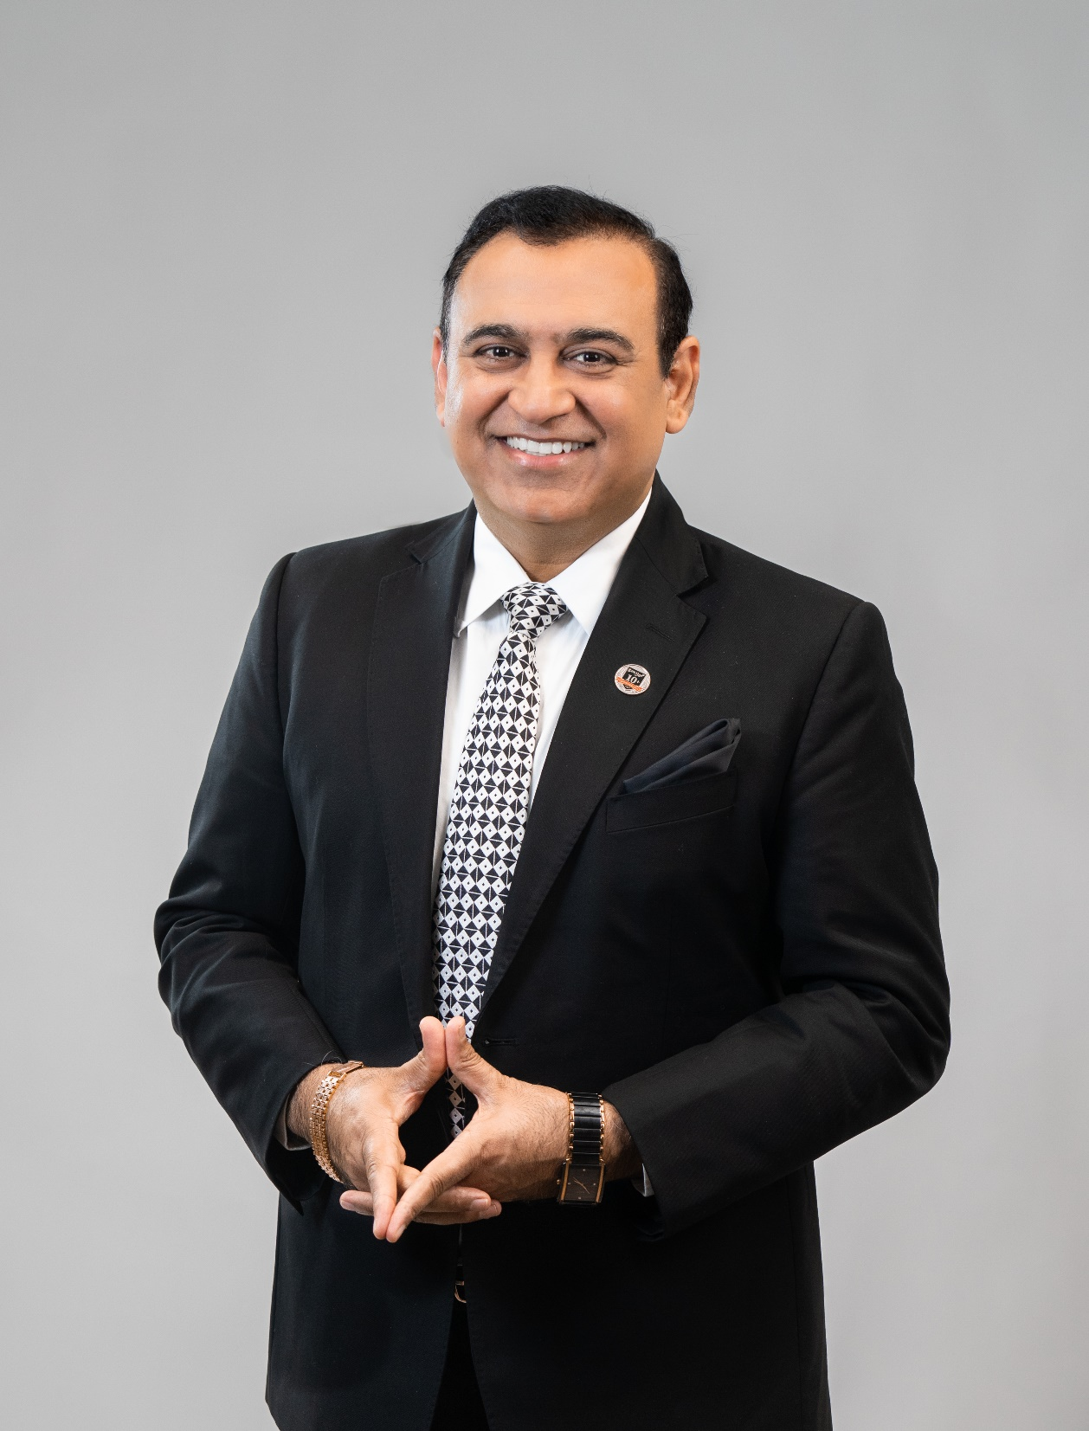
ABOUT ME
Based in Ontario
Founder / Group CEO of SaveMax
Top Realtor In Brampton
What really sets me apart is my expert real estate knowledge, excellent ability to communicate and advancement in using technology
Roots & and ties in all communities
Active involvement in community events & and charitable projects
RAMAN DUA
Founder / Group CEO

Slide 4
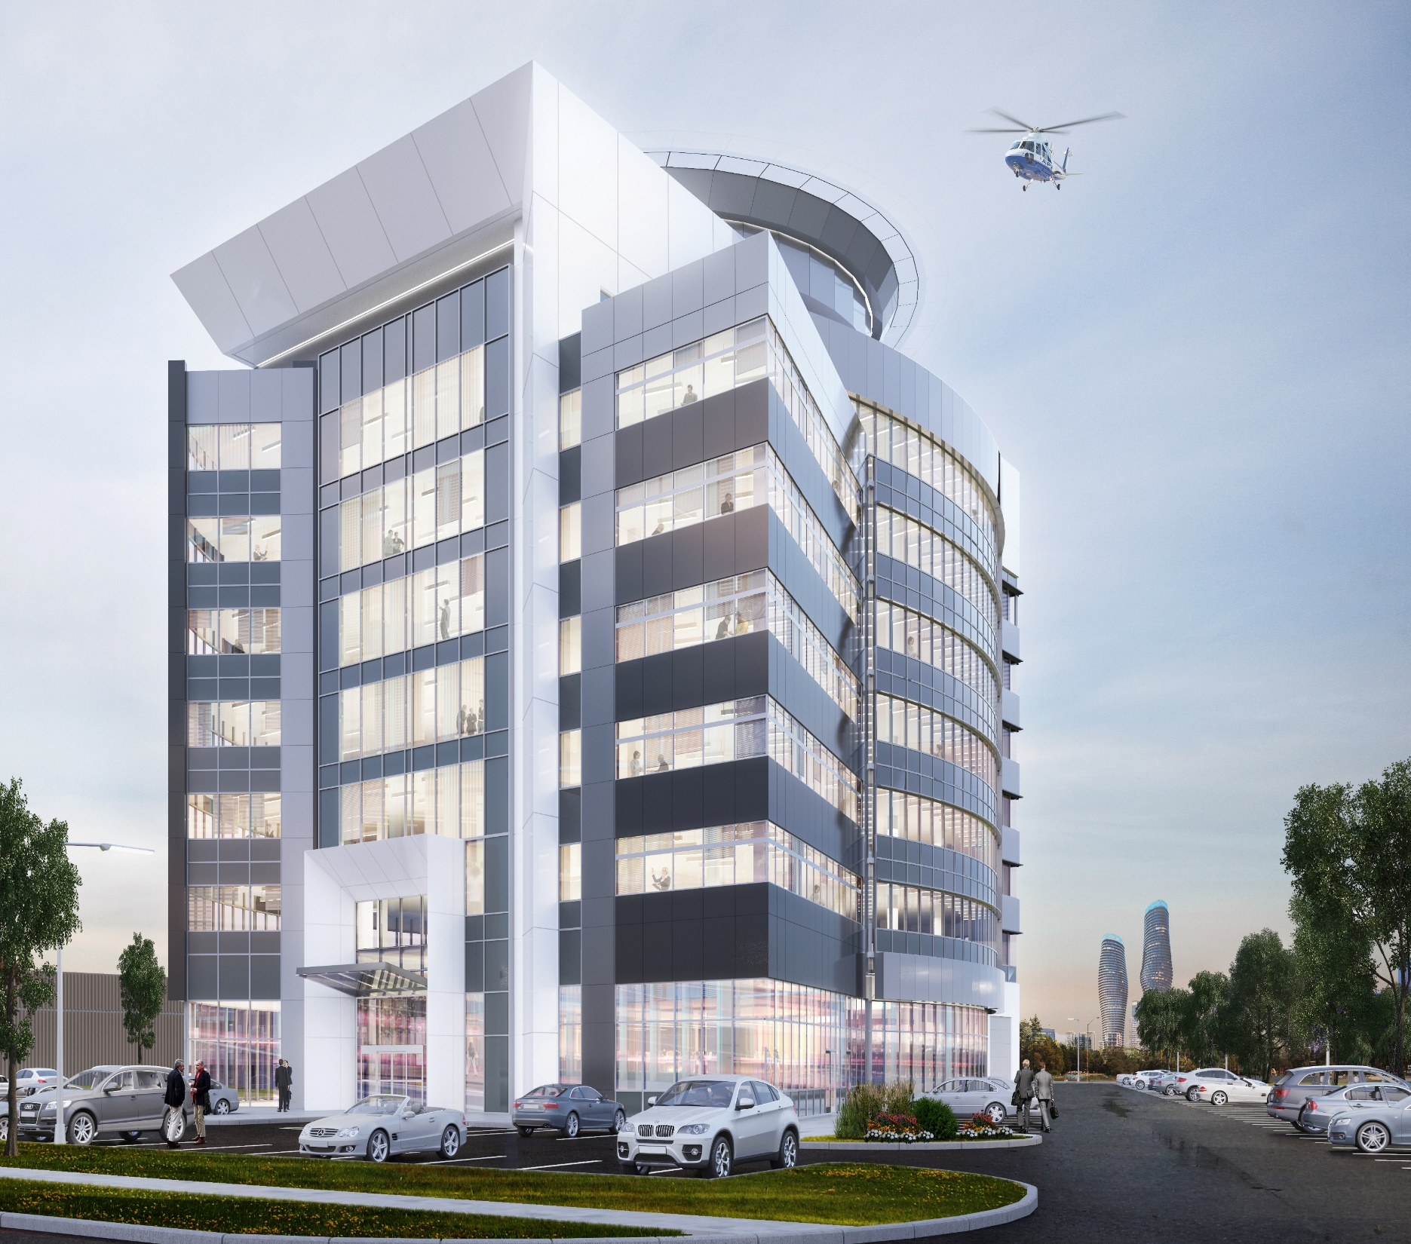
80+ Franchise Locations
Across Canada, India
& UAE
Canada
MISSISSAUGA | BRAMPTON | TORONTO | WINDSOR | MARKHAM | GEORGETOWN | CALEDON | GUELPH | OAKVILLE |
WOODBRIDGE | KITCHENER | WATERLOO | BURLINGTON | ETOBICOKE | BARRIE | CALGARY | EDMONTON | SURREY
WINNIPEG | MILTON | LONDON
Middle East
DUBAI | UAE
India
NEW DELHI | NOIDA | GHAZIABAD
GURUGRAM | MOHALI | JALANDHAR
AMBALA | HYDERABAD | BANGALORE
NAGPUR | AHMEDABAD
Coming Soon
OTTAWA
ABOUT
SAVE MAX
CORPORATE OFFICE:
305-1550 Enterprise Rd,
Mississauga ON

Slide 5
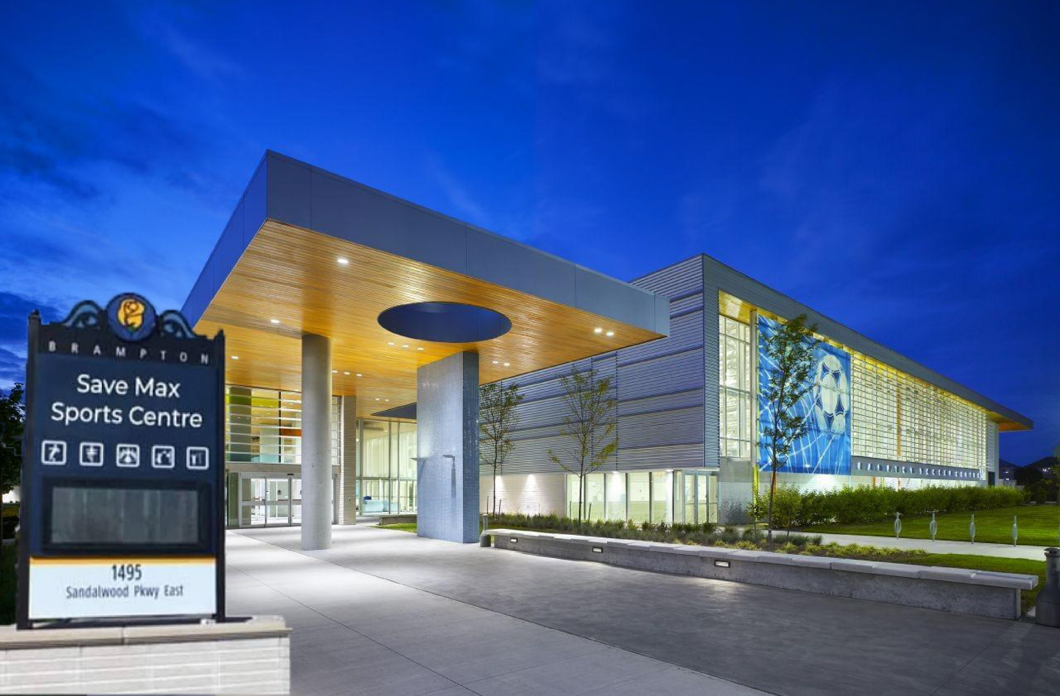


Slide 6


Slide 7







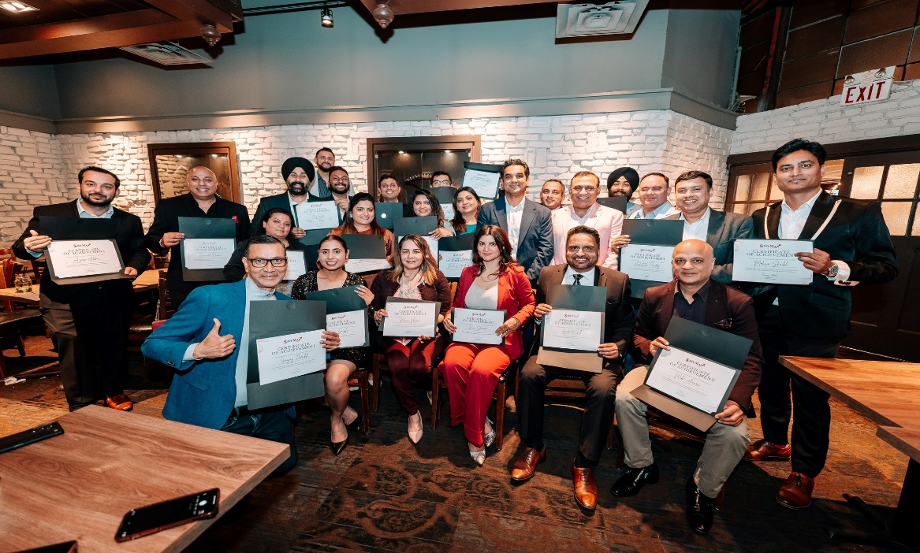




JUST A LITTLE BAGROUND…
Established in 2010, Save Max is one of the Fastest Growing Companies in GTA.
Sold over *$18+ Billion Real Estate Volume & completed *20,500+ transactions till date.
Premier full-service brokerage with
top-rated agents offering the highest
level of real estate services to clients.
*Total Sales Volume & and number of transactions by Save Max Real Estate Brokerage from April 2010 until today where Save Max acted as a Listing/Co-operating Brokerage.

Slide 8




Strategic Partnerships with Canada’s Leading Financial Institutions to create exceptional value for our clients

Slide 9























STRONG RELATIONS WITH TOP BUIDERS
Save Max carries excellent working relationships with all Top builders and developers to pass on the platinum privileges to all our clients.

Slide 10
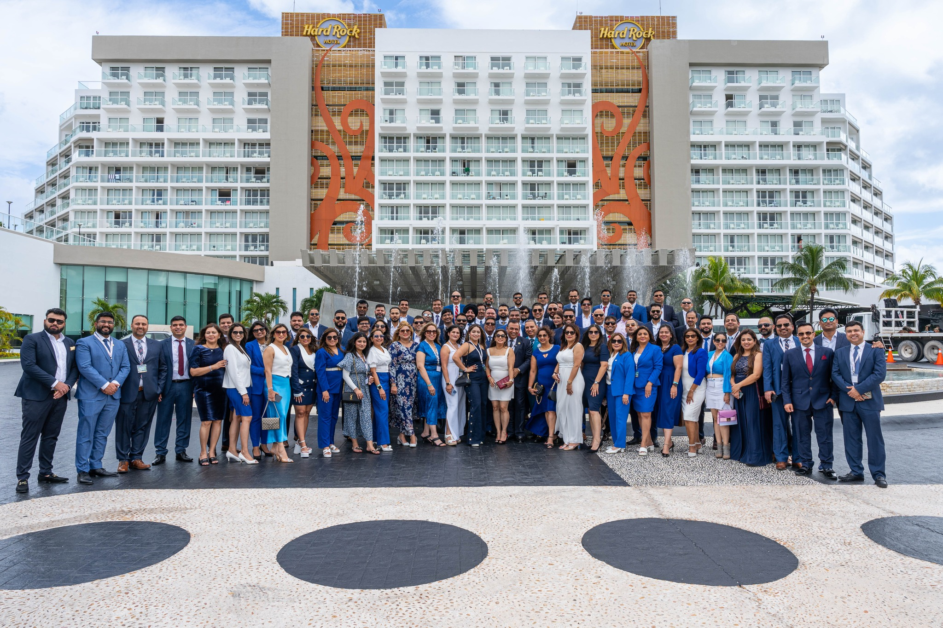
A Trusted Team Dedicated to Your Success

Slide 11

TRUTH OF REAL
ESTATE MARKET
Registered Agents on TRREB: 73,000
Agents doing 0 deals: 37%
Agent doing 1-6 deals: 47%
Agents doing 7-12 deals: 9%
Agents doing 12-24 deals: 4%
Agents doing 25-35 deals: 2%
Agents doing 36+ deals: 1% ONLY
* Based on data provided by IMS for approximate deals done by agents in Toronto real estate market

Slide 12
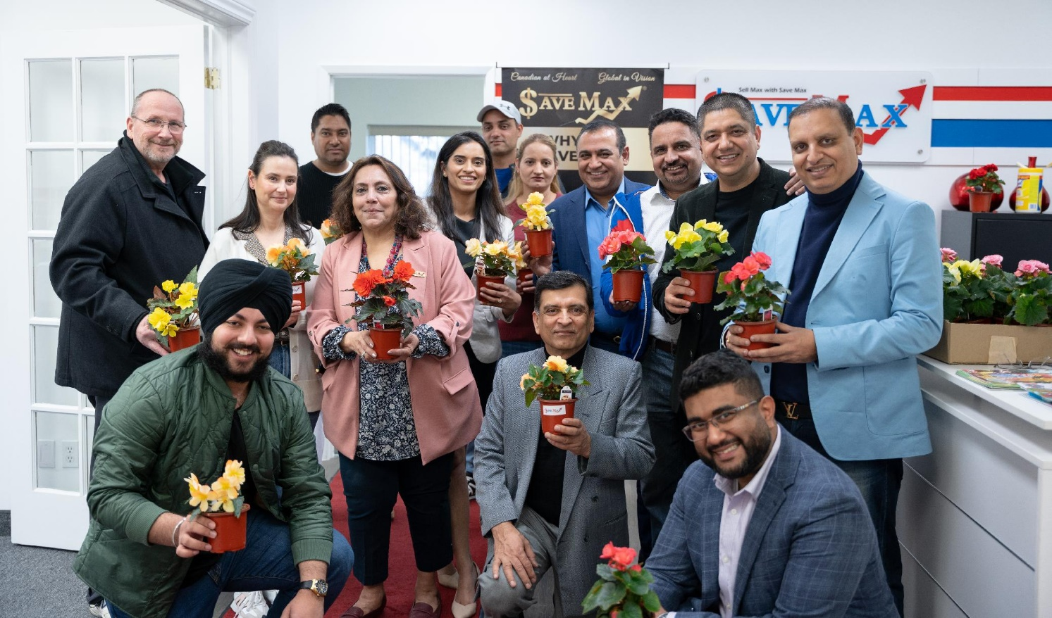
WHAT WE OFFER
AS A TEAM
Elite Team of Professionals with Average 4+ years of Experience.
National and international pool of buyers and investors.
Extensive network & connections with other agents to promote our listings.
Save Max team brings the skill set needed to sell properties at top dollar.

Slide 13

WHEN WILL IT SELL?
Your home will have the most activity within the first 60 days on the market. CORRECT PRICING is the most important thing you can do to sell your home quickly and for the MOST MONEY.

Slide 14
How does Save Max produce results?
Pre-Marketing
Marketing
Post-Marketing

Slide 15

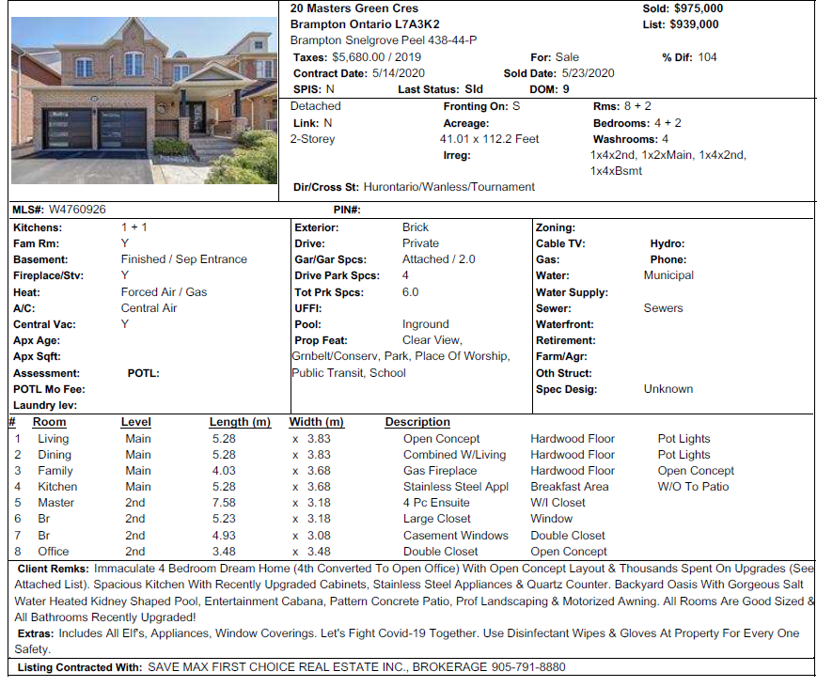
To attract the right buyers, we do
PRE-MARKETING
MLS
YARD SIGN
ACCURATE PRICING
PROFESSIONAL
VIRTUAL TOUR
PREMIUM FEATURE SHEETS
BRAND WEBSITE
PROFESSIONAL STAGING
DRONE SHOOT FOR AERIAL IMAGES

Slide 16


To attract the right buyers, we do
PRE-MARKETING
MLS
YARD SIGN
ACCURATE PRICING
PROFESSIONAL
VIRTUAL TOUR
PREMIUM FEATURE SHEETS
BRAND WEBSITE
PROFESSIONAL STAGING
DRONE SHOOT FOR AERIAL IMAGES

Slide 17
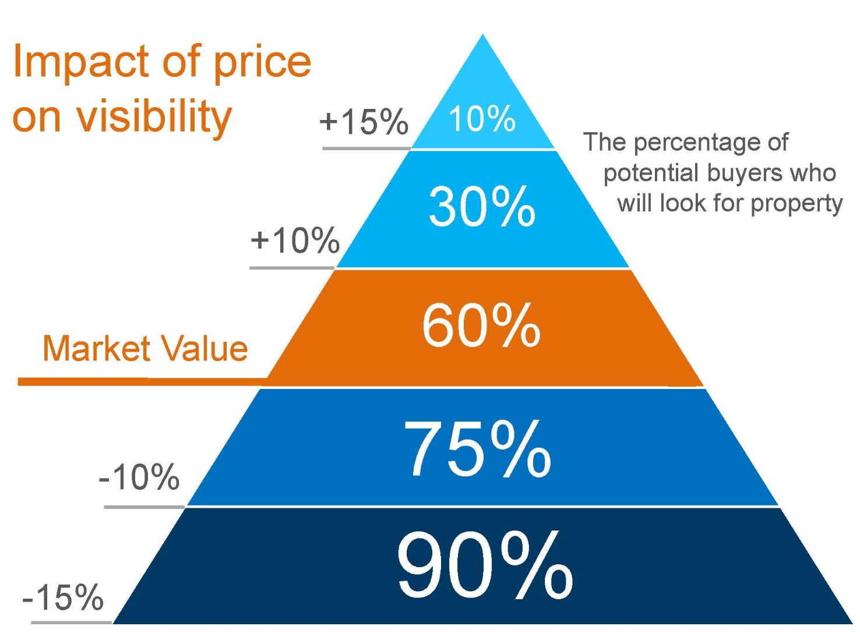
To attract the right buyers, we do
PRE-MARKETING
MLS
YARD SIGN
ACCURATE PRICING
PROFESSIONAL
VIRTUAL TOUR
PREMIUM FEATURE SHEETS
BRAND WEBSITE
PROFESSIONAL STAGING
DRONE SHOOT FOR AERIAL IMAGES

Slide 18
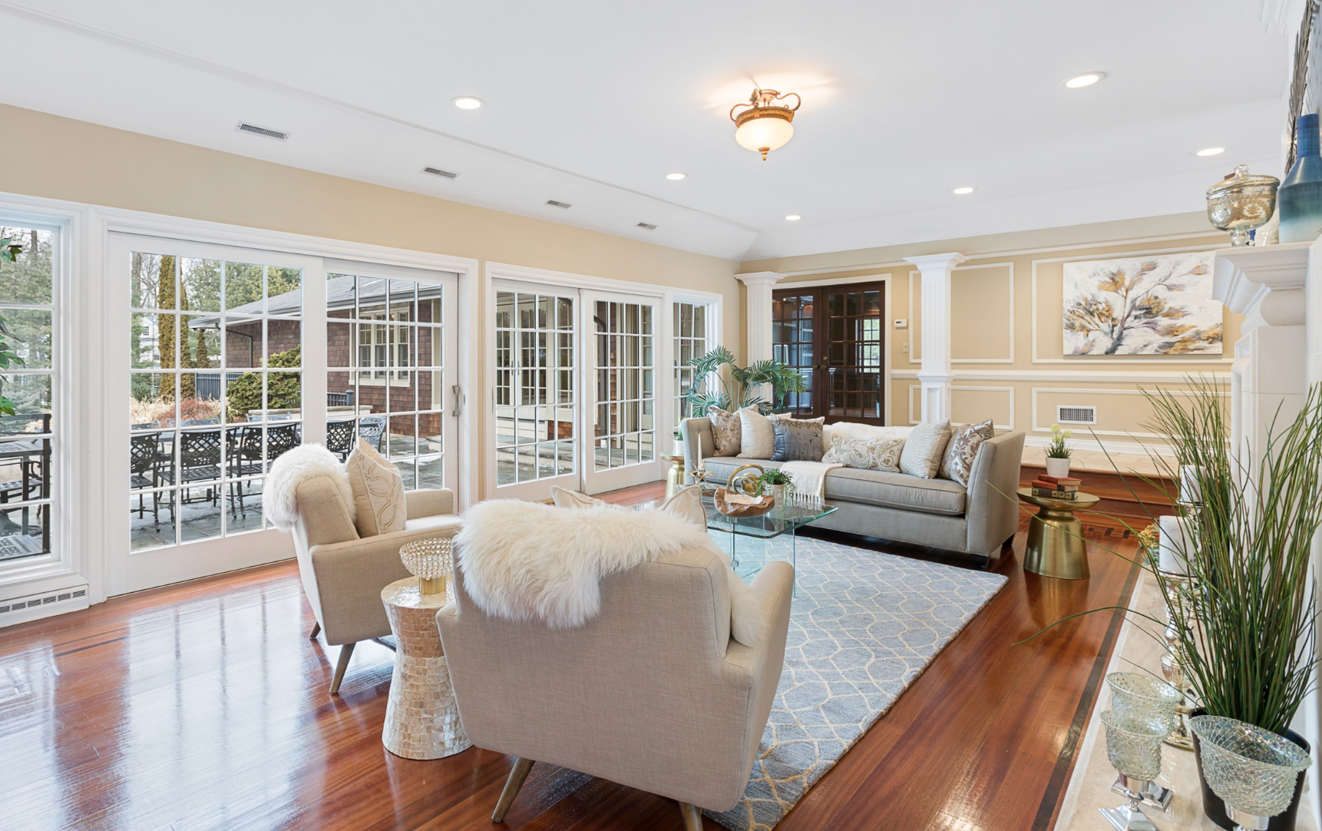
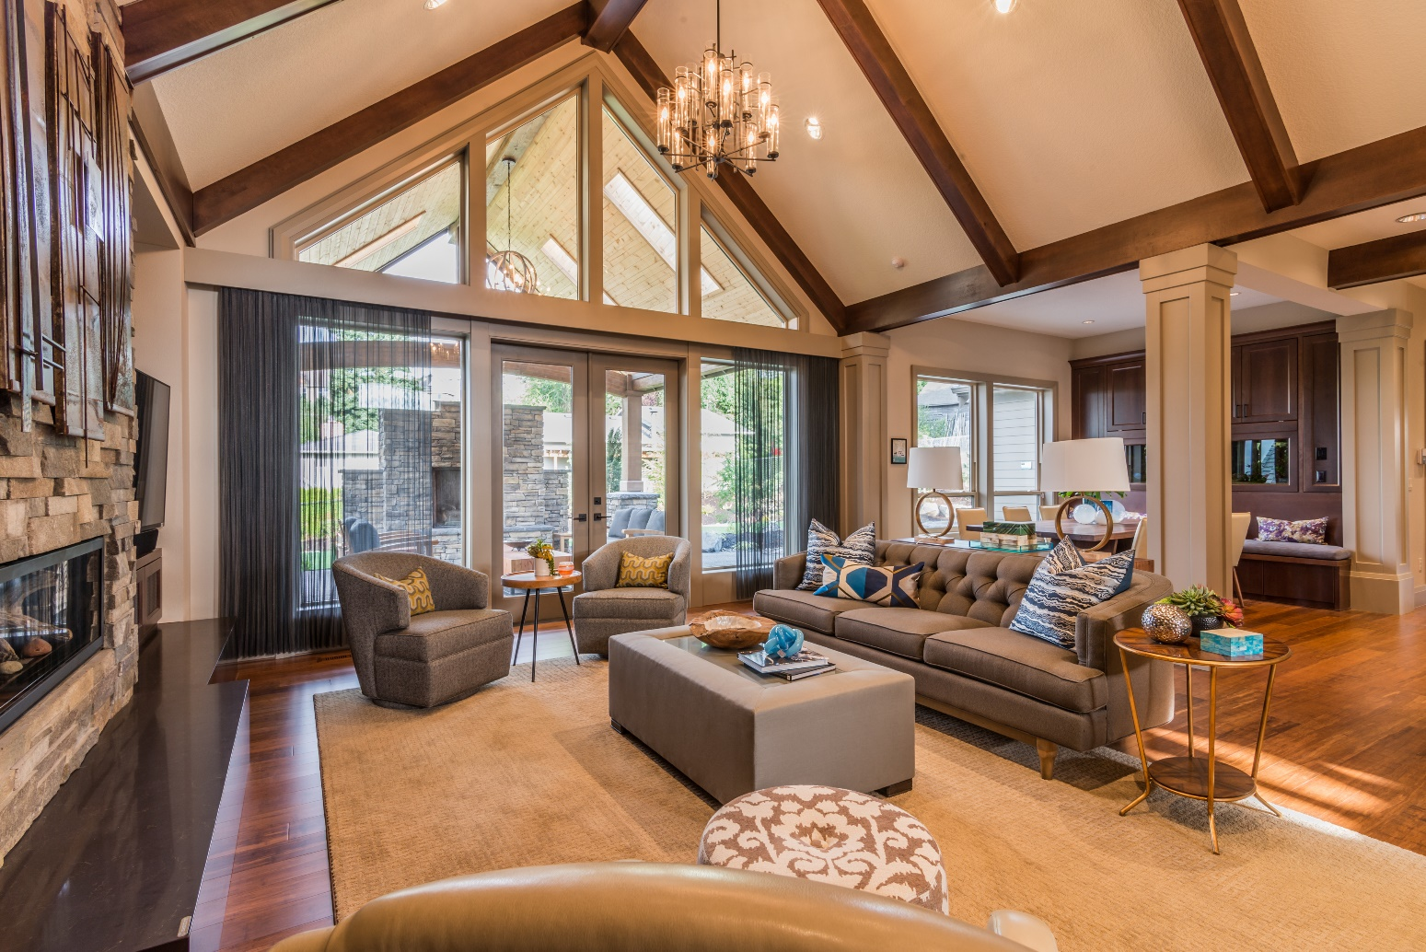
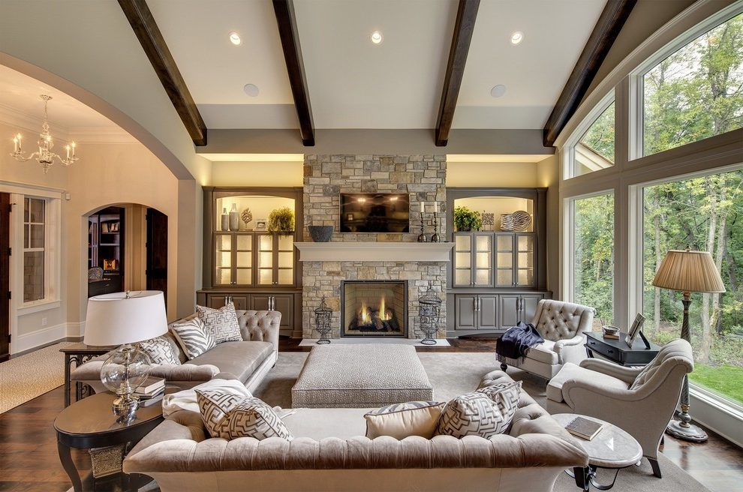
To attract the right buyers, we do
PRE-MARKETING
MLS
YARD SIGN
ACCURATE PRICING
PROFESSIONAL
VIRTUAL TOUR
PREMIUM FEATURE SHEETS
BRAND WEBSITE
PROFESSIONAL STAGING
DRONE SHOOT FOR AERIAL IMAGES

Slide 19
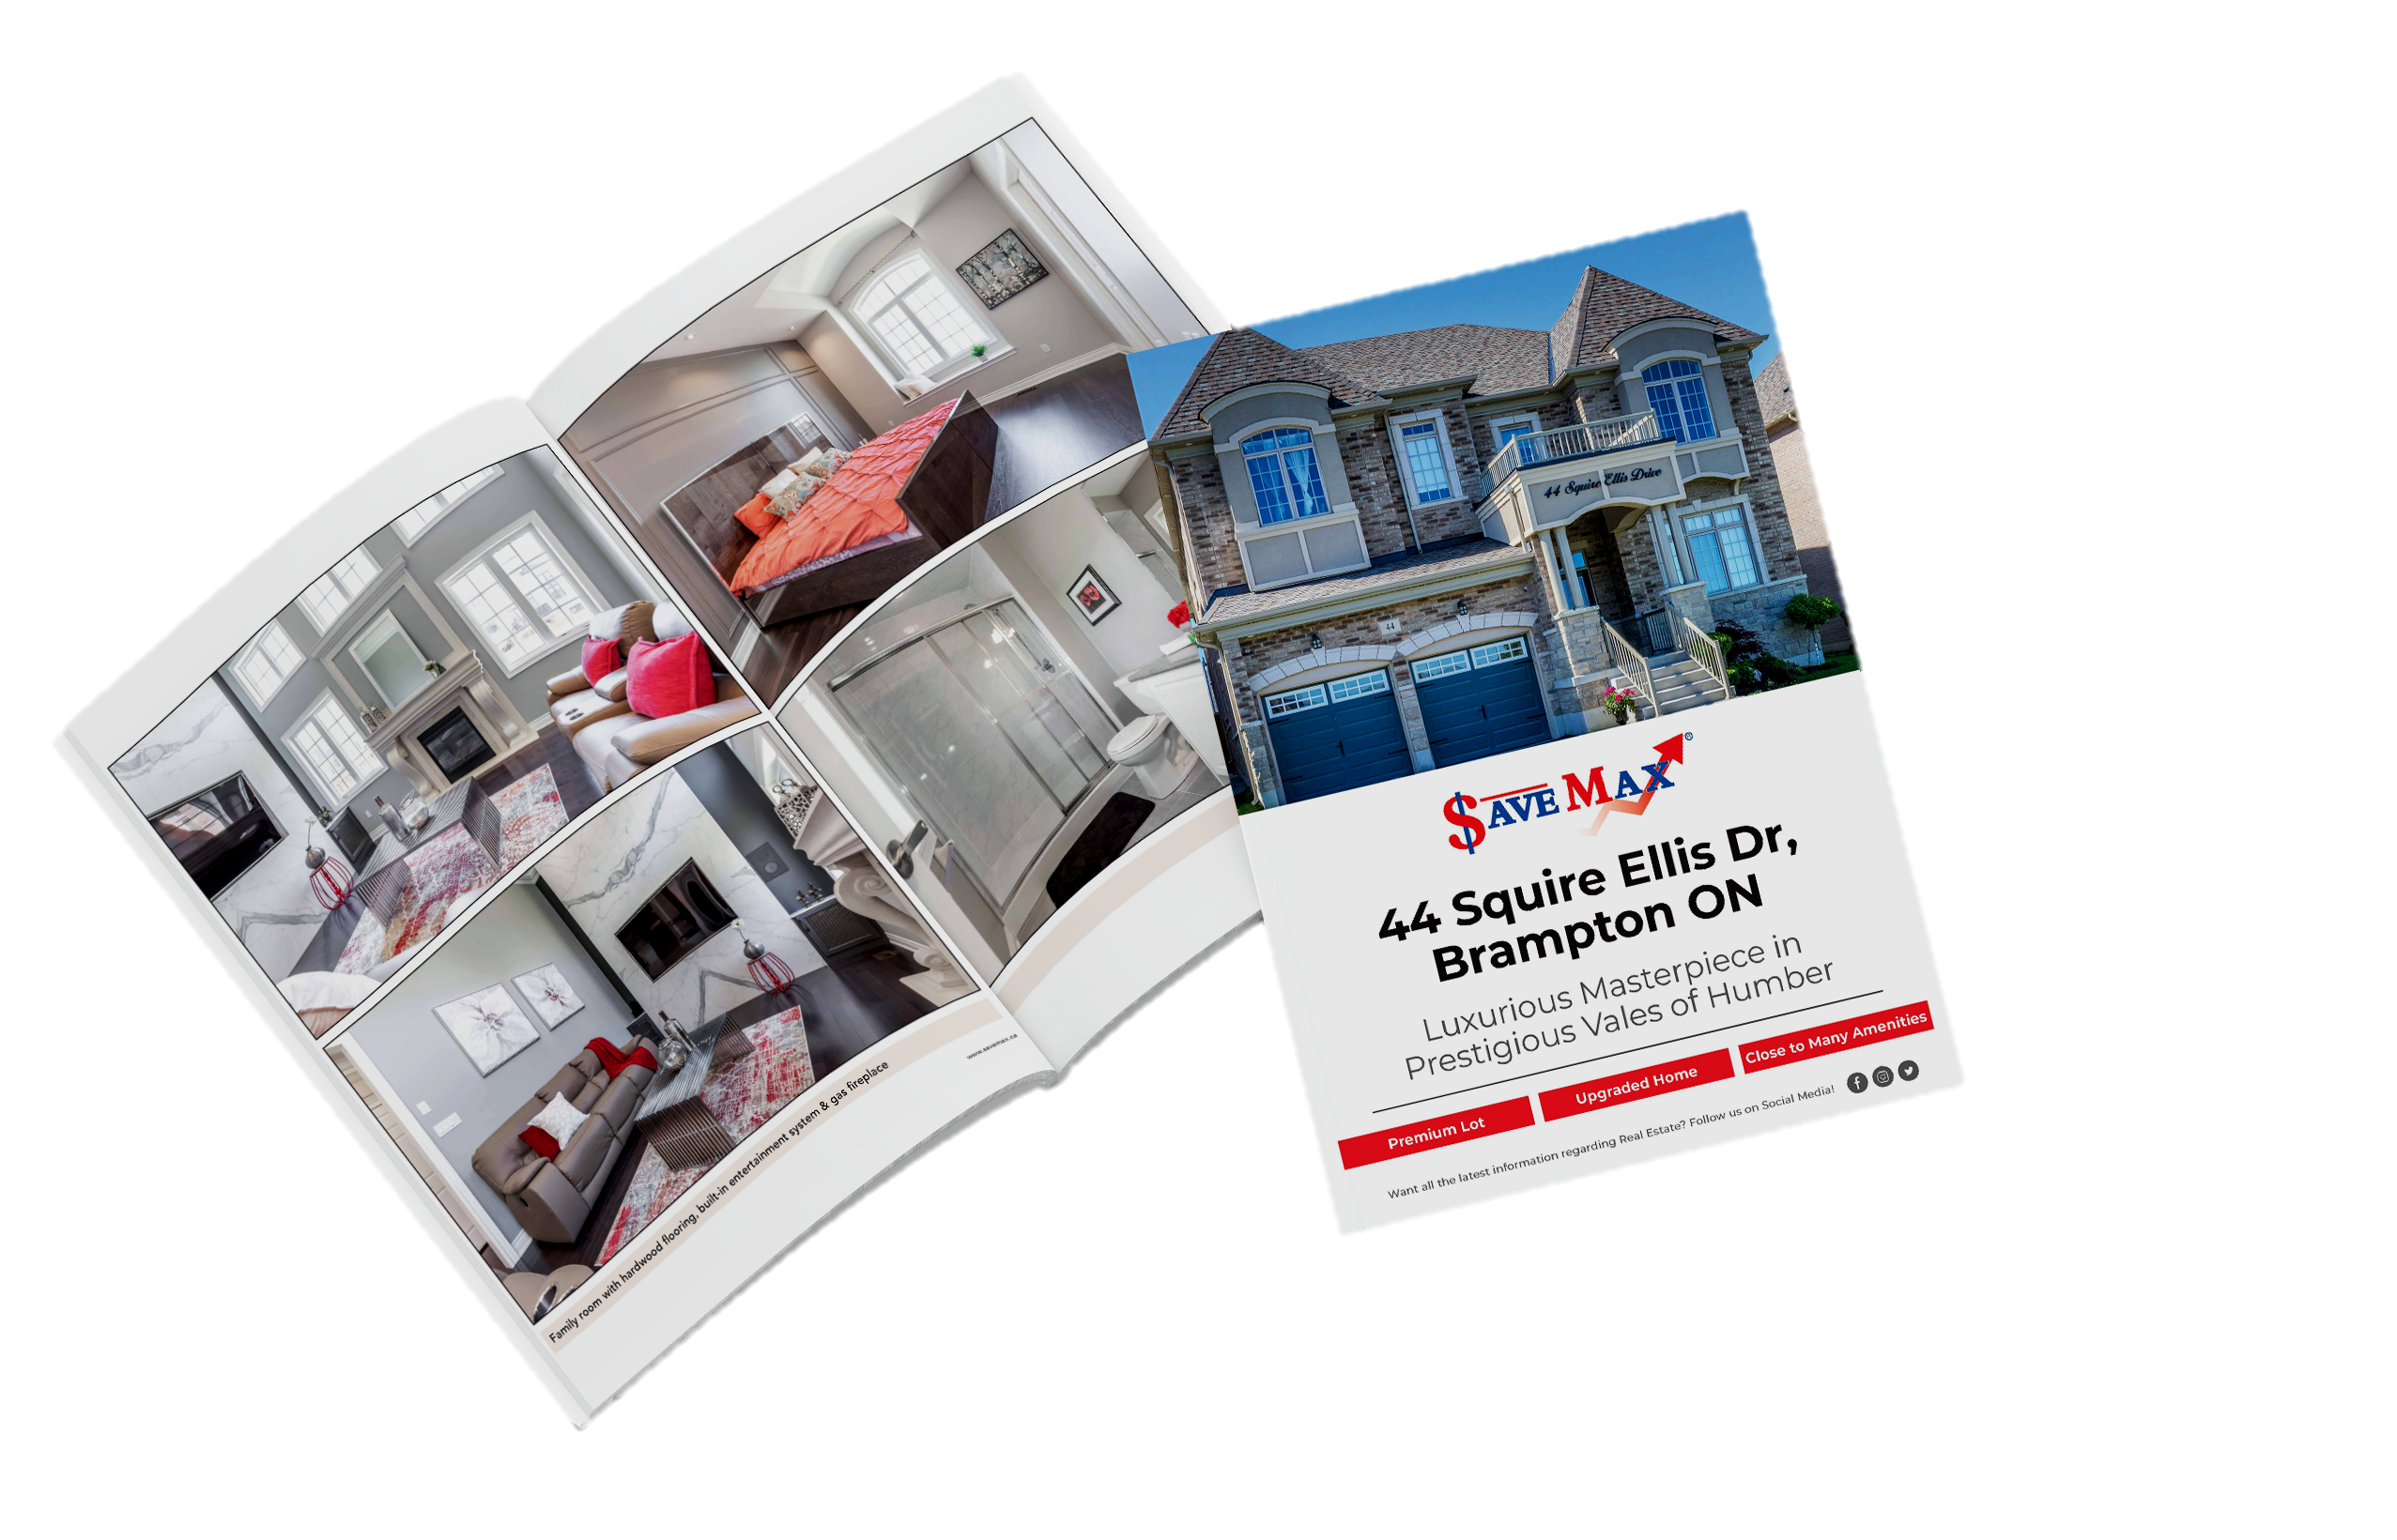
To attract the right buyers, we do
PRE-MARKETING
MLS
YARD SIGN
ACCURATE PRICING
PROFESSIONAL
VIRTUAL TOUR
PREMIUM FEATURE SHEETS
BRAND WEBSITE
PROFESSIONAL STAGING
DRONE SHOOT FOR AERIAL IMAGES

Slide 20
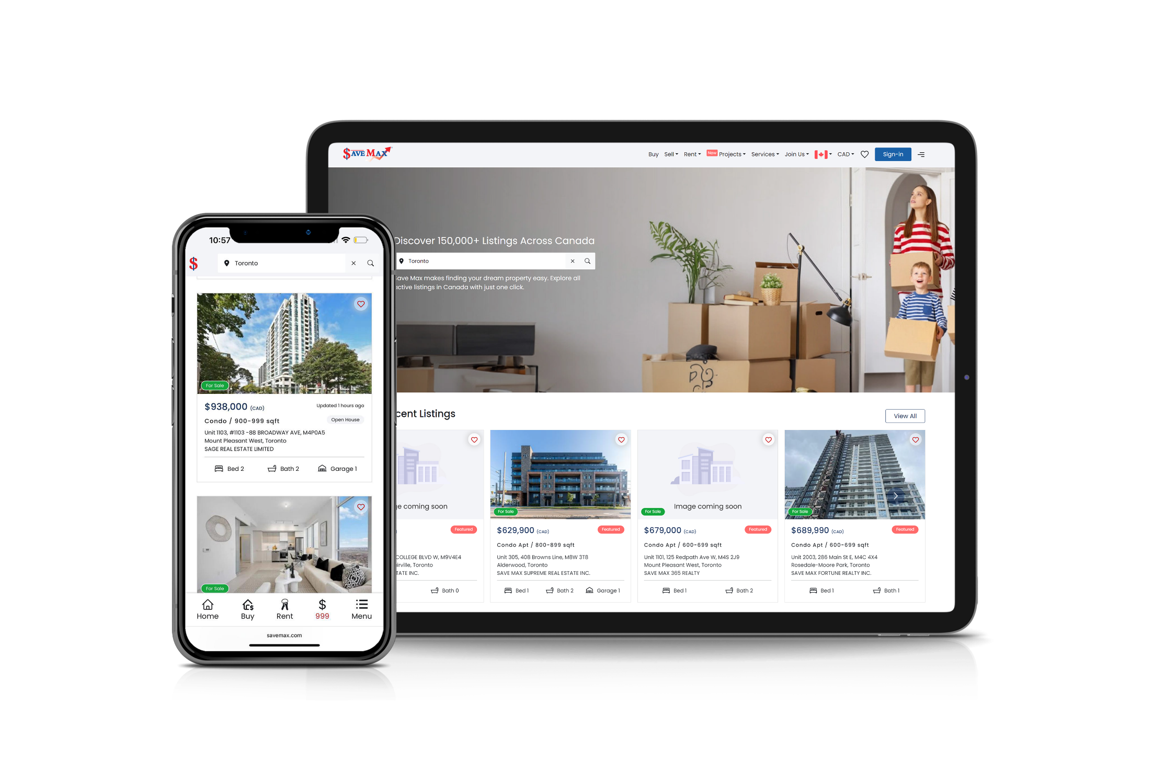
To attract the right buyers, we do
PRE-MARKETING
MLS
YARD SIGN
ACCURATE PRICING
PROFESSIONAL
VIRTUAL TOUR
PREMIUM FEATURE SHEETS
BRAND WEBSITE
PROFESSIONAL STAGING
DRONE SHOOT FOR AERIAL IMAGES

Slide 21
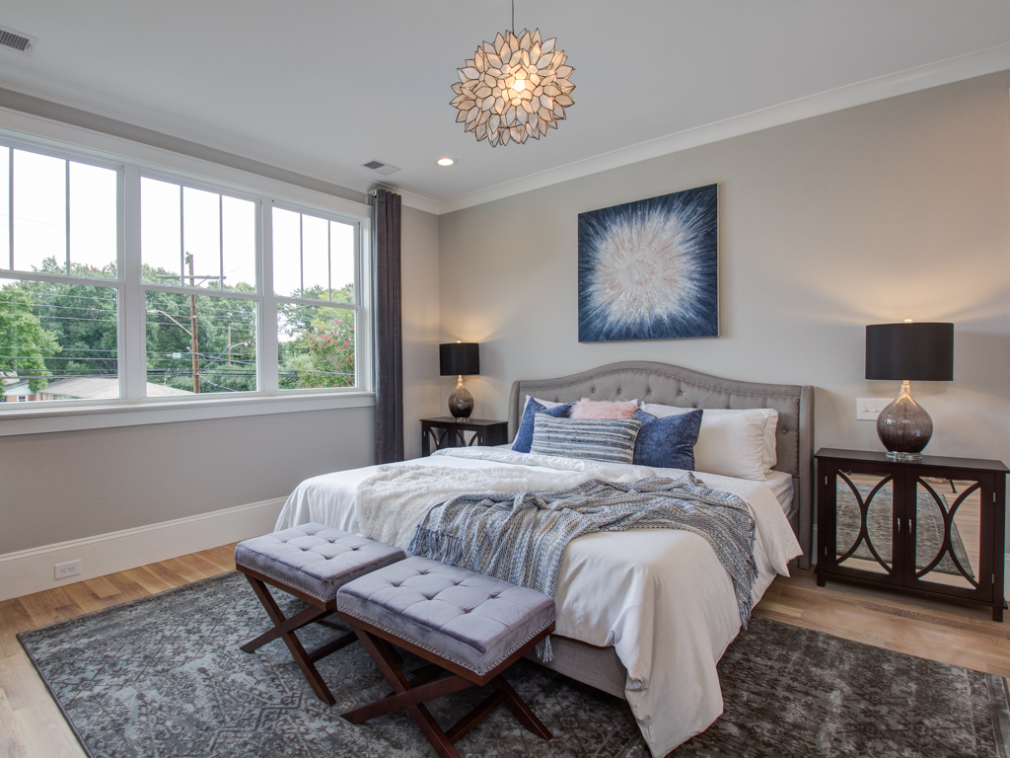
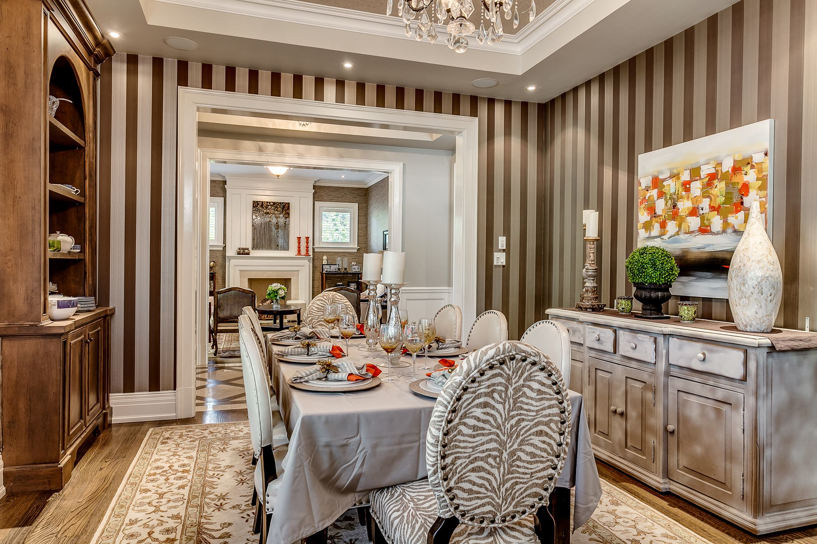
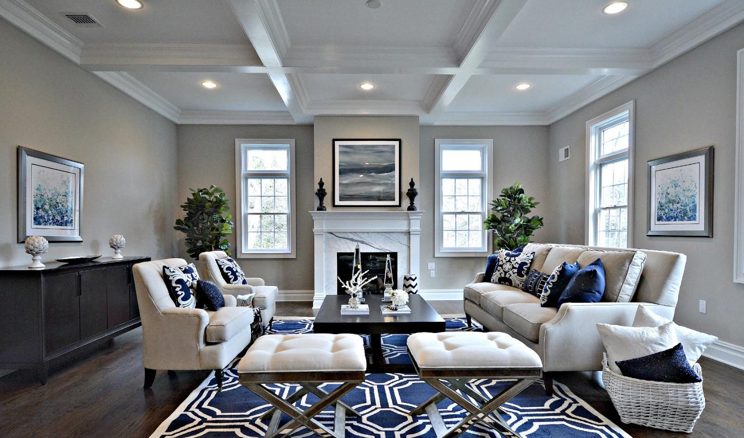
To attract the right buyers, we do
PRE-MARKETING
MLS
YARD SIGN
ACCURATE PRICING
PROFESSIONAL
VIRTUAL TOUR
PREMIUM FEATURE SHEETS
BRAND WEBSITE
PROFESSIONAL STAGING
DRONE SHOOT FOR AERIAL IMAGES

Slide 22
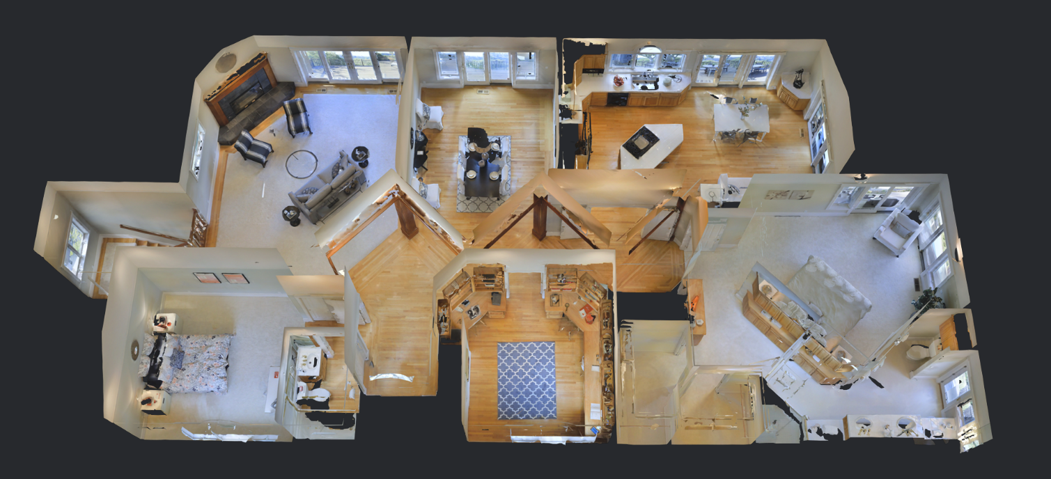
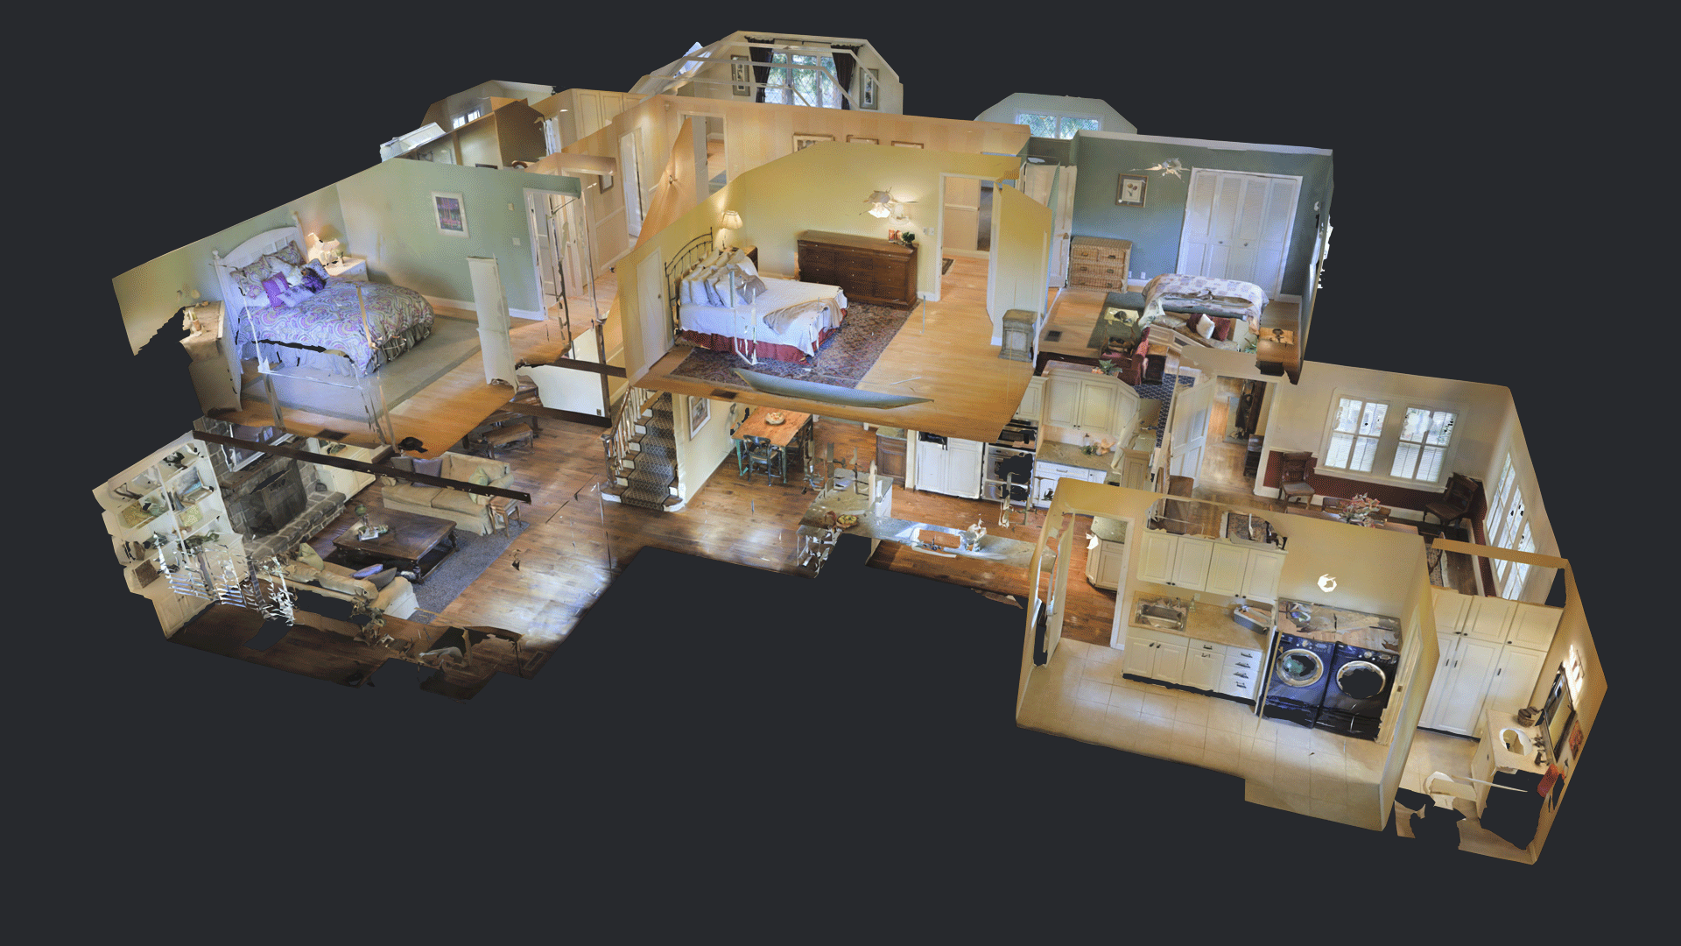
To attract the right buyers, we do
PRE-MARKETING
MLS
YARD SIGN
ACCURATE PRICING
PROFESSIONAL
VIRTUAL TOUR
PREMIUM FEATURE SHEETS
BRAND WEBSITE
PROFESSIONAL STAGING
DRONE SHOOT FOR AERIAL IMAGES

Slide 23







MARKETING YOUR PROPERTY
(Post-Listing)
We take time Each Day to Go Out, Spread the Word, actively prospect the marketplace and blast your Home for Sale across the Internet & Social Media Network to Actively look for a Buyer for your Property.

Slide 24


FLYERS & PRINT MATERIALS

Slide 25


HEAVILY ADVERTISED OPEN HOUSES
150k Followers
5 Million Reach

Slide 26
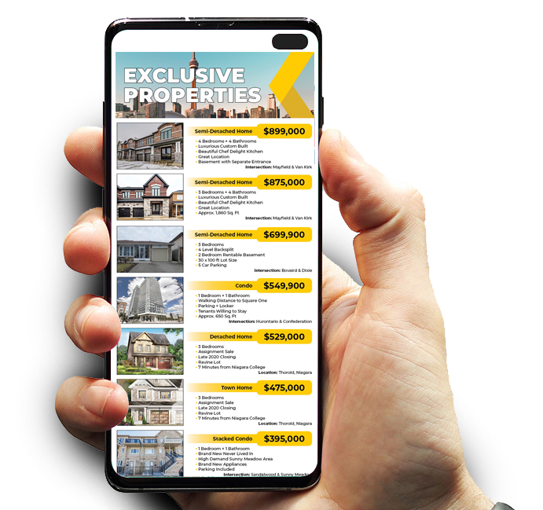
EMAIL PROMOTIONS
VIRTUAL OPEN HOUSE STRATEGY- COVID SITUATION
Huge database and pool of buyers to market upcoming listings to thousands of targeted consumers by sending out well designed and resourceful e-blasts to warrant our recipients' precious time and attention.

Slide 27













Promoting Your Home

Slide 28



SOCIAL MEDIA MARKETING

Slide 29





RADIO ADVERTISING

Slide 30

WHAT MAKES
NUMBER ONE?
Notes:
Need to redo this slide.

Slide 31


WHAT MAKES US

Slide 32









CLIENT APPRECIATION EVENTS
Each year we try to do a number of activities to thank all of our clients for their loyalty and continued support. Although, these activities may change from year-to-year, here is a sample of what you can expect.
HALLOWEEN CONTEST
CHRISTMAS MAKE-A-WISH
DRAWING COMPETITIONS
ICE SKATING & SWIMMING
ROLLER SKATING/IN-LINE SKATING
MOVIE SCREENINGS
CLIENT BBQ
& MUCH MORE..

Slide 33



COMMISSION PACKAGES

Slide 34
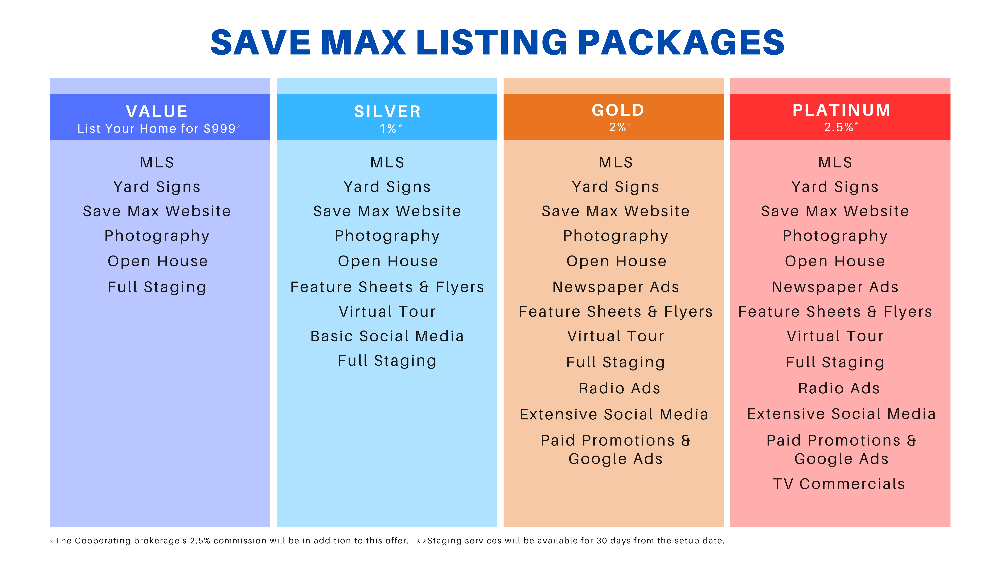

Slide 35
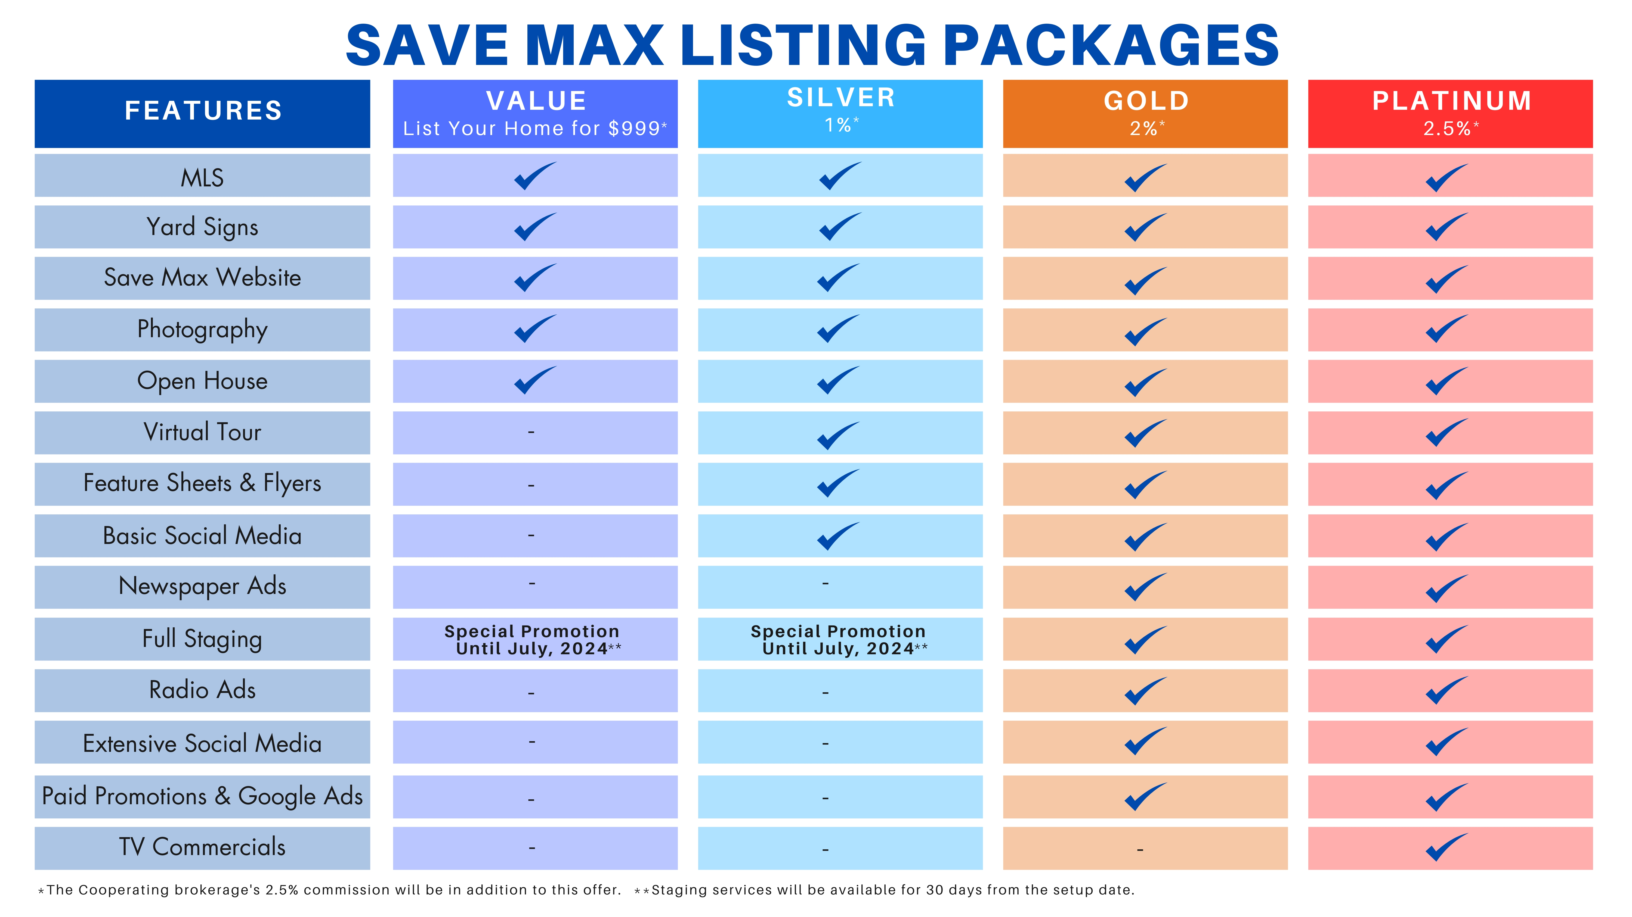

Slide 36

GETTING STARTED
GETTING STARTED IS EASY!
Once we have agreed on a price,
and have answered all your questions, We will have some paperwork to complete. Once the paperwork is done, we can have your Home on the Market in as little as 48 hours.
We will be pleased to welcome you to
SAVE MAX FAMILY!

Slide 37


Thank You!
Thank You!
Mobile 647.225.5780
Office: 905.459.7900
Email : raman.dua@savemax.com
RAMAN DUA
BROKER OF RECORD

